Slide 1
DENNIS NGIGI KAMANDE S080-01-1879/2020 BSC INDUSTRIAL CHEMISTRY Communication skills
Photographic essay

Slide 2
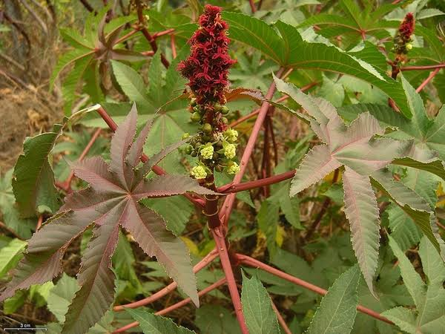
There are different types of traditional medicine that re used by the Kalenjin community in Kenya
Senetwet
This type of plant is greeny and with yellow flowers
It is added to milk for medicinal purposes and taste improval.
This,however, plays a role in treatment of throat cancers.

Slide 3
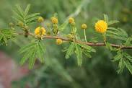
Sepet
Used for treating respiratory disorders

Slide 4
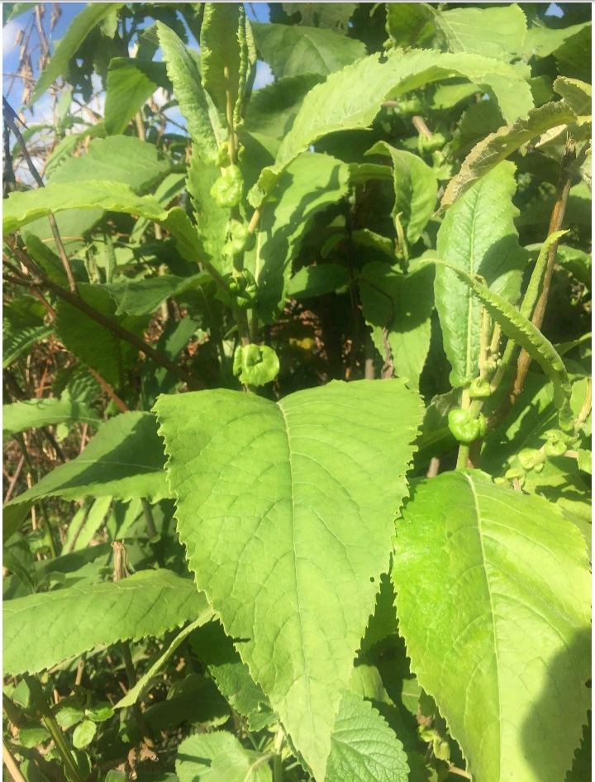
Maronget
This a type of plant that was used in treatment in extexternal ailments majorly leg fractures
It was placed near the fire then pressed at fracfractured part whereby the juices could penetrate into the skin
The picture of the plant is shown below

Slide 5
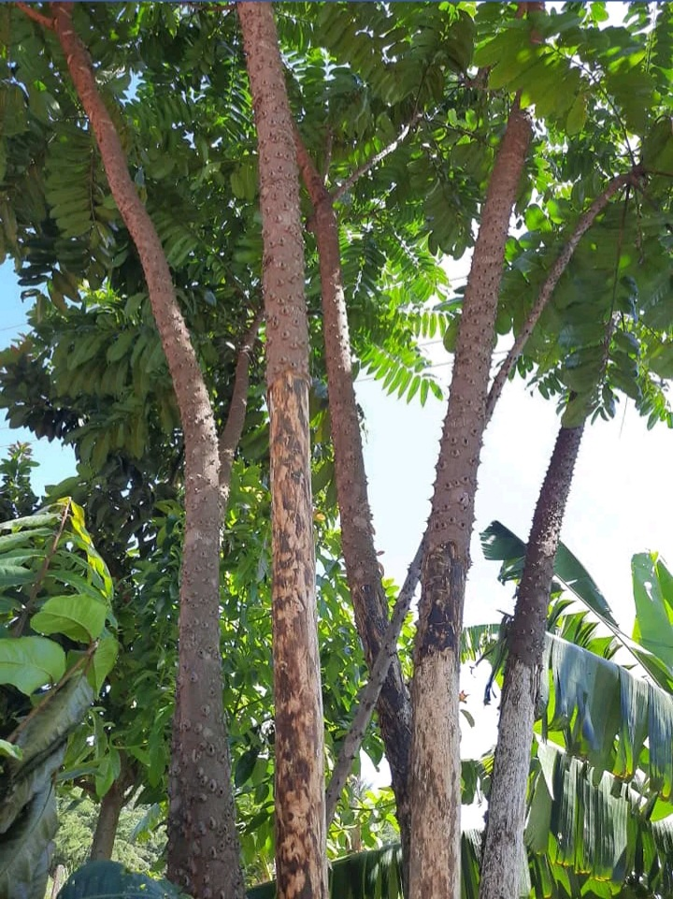
Sagawaita
It is a type of plant that has torns in its stem with thick bark.
The bark of this tree is used in treatment of fever.
It is also used for the symptoms related to runny Nose,cough, Sore Throat, Tonsillitis, Flu, and Fever.
The picture of the tree is shown below

Slide 6
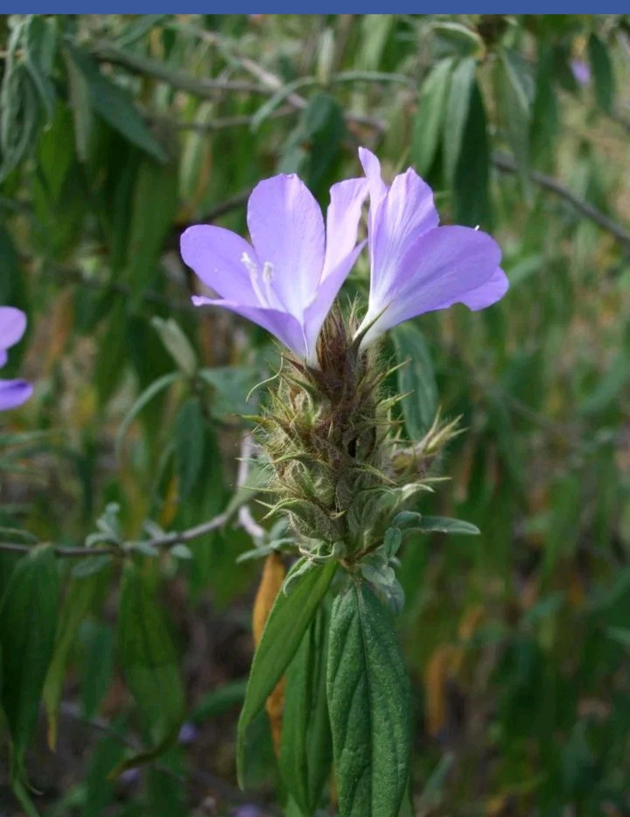
Cheperenet(Barleria)
It is a plant which contain some flowers which are used for treatment oof cough and back aches.
It is also used as treatment to areas when on eis bitten by a snake or other poisonous insects like the spider.

Slide 7
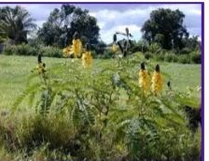
Itet
This type of plant is greeny and with yellow flowers
It is added to milk for medicinal purposes and taste improval.
This,however, plays a role in treatment of throat cancers.

Slide 8
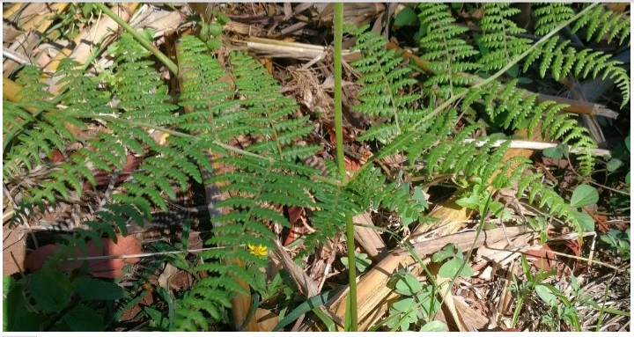
Tilalwet
This is a type of plant in which its shoots are used for external treatment s like the skin.
The shoots are burnt into ashes and the ashes are spspread on the surface of the skin where it performs the treatment.

Slide 9
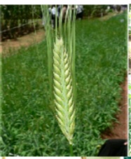
Chemurguiywet
Its tiny leaves are used in the treatment of cough.
It is also used for external treatments like the skin

Slide 10
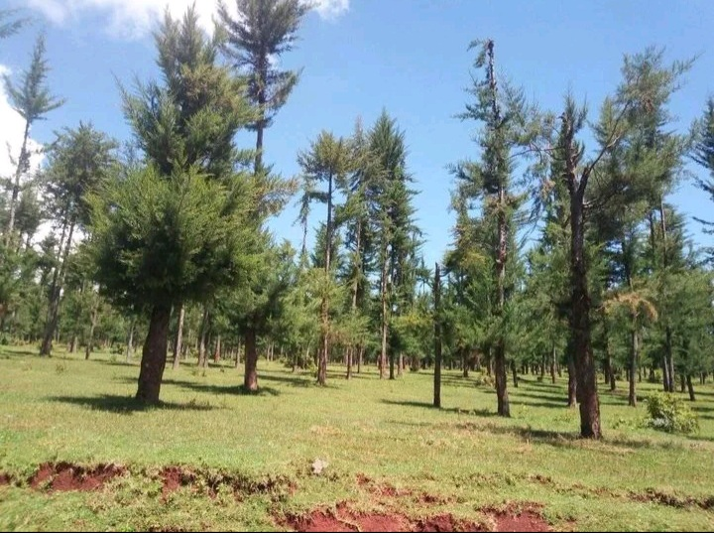
Ndakariat
It's leaves ashes are used for treating dry cough.
It is also used for cancer treatment
The are also used for asthma treatment.
also used when one is having the problems of flu and tonsils

Slide 11
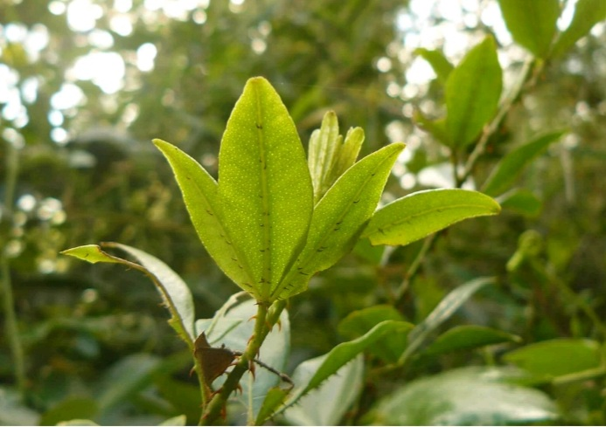
Chepindorwet
This is a type of plant which is torn on its stem and it is smelly
It is used in treatment of common cold,fever and removal of pimpleson the fafaces of people.

Slide 12
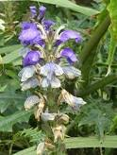
Tekelte
Used for Abdominal cramps,joint pains

Slide 13
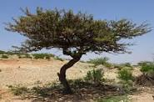
Chuya
Used for treating cancer.

Slide 14
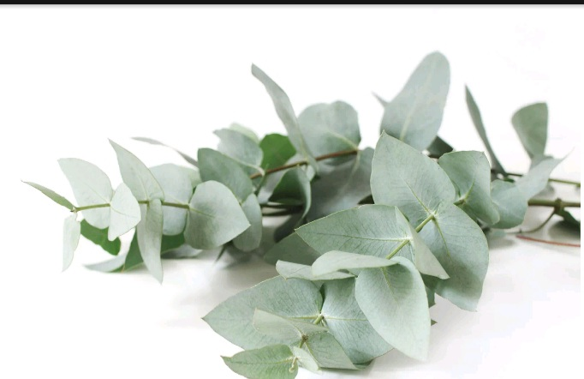
White blue gum tree
It is used to reduce symptoms of congestion coughs and colds.
It also features in creams and ointments aimed at relieving muscle and joint pain.
Its leaves are used to treat skin conditions like the ringworms,athletes foot and cold sores because off its antibacterial properties.
Its leaves are boiled and the air evaporating is used in treatment of skin diseases in the infants.

Slide 15
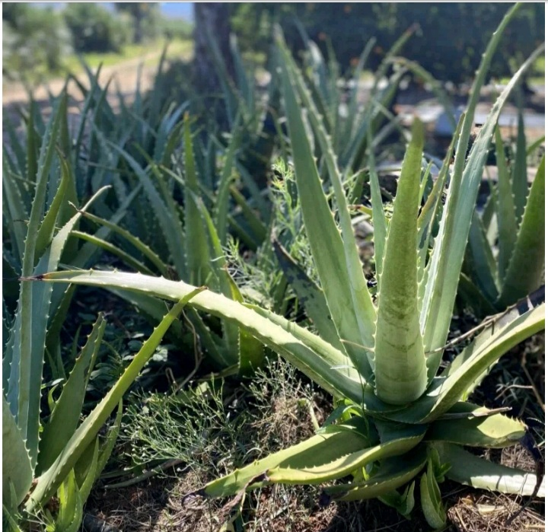
Aloe vera(Tangaratwet)
This is a type of plant that mainly grow in dry areas.
It was mainly used by the kipsigis community to
cure the external wounds.
It was also used to treat the ringworms
They were also used to treat malaria and typhoid
It was uused for external skin

Slide 16
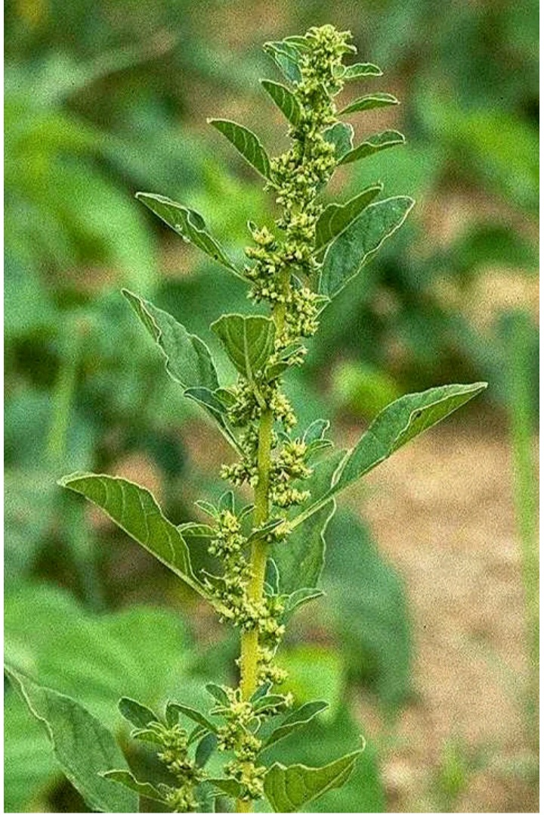
Mbogiat
Its leaves are used for canver treatment and boils.

Slide 17
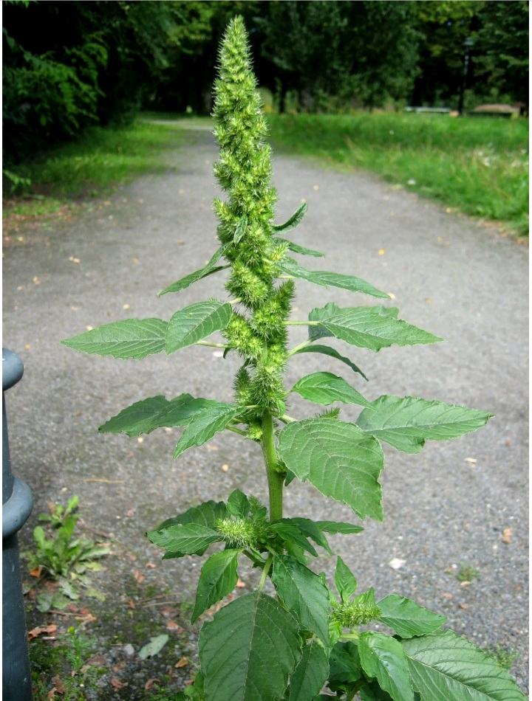
Chesirimiot/chesirimto
It is a root ash used for cough treatment

Slide 18
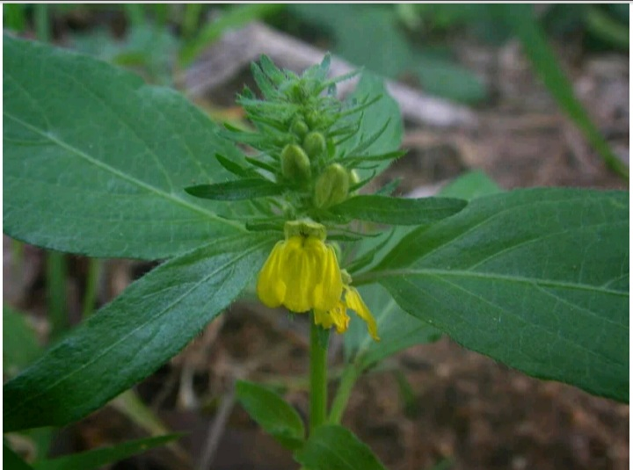
Chepyochoit
Leaves are burnt to ashes and were used for sorcery purposes
It was also used in the in the treatment of ulcer and pneumonia.

